Slide 1












Routes to Roots
A celebration of migration
KS2 Learning Resource

Slide 2
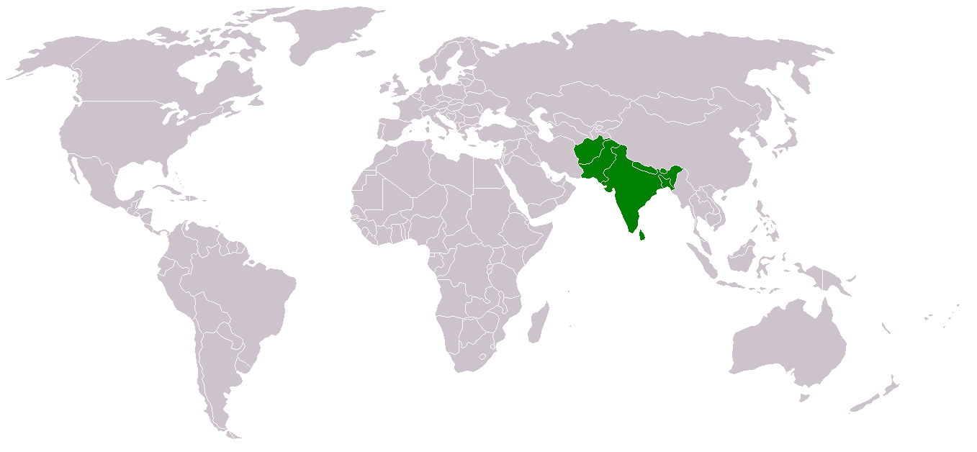
What is Routes to Roots?
Routes to Roots celebrates South Asian people and their experiences, moving to the UK.
South Asian people have been living in the UK for hundreds of years. Lots of British life today has been influenced by the people who have migrated from the Indian subcontinent, from the tea we drink, to doing yoga and the word pyjamas!
South Asian countries include: Afghanistan, Bangladesh, Bhutan, India, the Maldives, Nepal, Pakistan, and Sri Lanka.

Slide 3
What is Migration?

Slide 4

What is Migration?
Migration means...
going from one place to another. For example, somebody moving house from somewhere else in the country or world to Bradford. Or, maybe somebody moving from another country to Britain.

Slide 5
How might it feel to migrate?

Slide 6
What is Diversity?
Migration means...
going from one place to another. For example, somebody moving house from somewhere else in the country or world to Sheffield. Or, maybe somebody moving from another country to Britain.

Slide 7
What is Diversity?
Migration means...
going from one place to another. For example, somebody moving house from somewhere else in the country or world to Sheffield. Or, maybe somebody moving from another country to Britain.
Diversity means...
the things that make people different. So this could be their life experiences, their age, the place that they come from, their gender, their hair or eye colour, how curly or straight somebody’s hair is, their skin colour, their religion. There are lots of different things that makes us who we are.

Slide 8
Different communities from around the world have settled in Britain for thousands of years. What do you think that tells us?

Slide 9
What does it tell us that people speak different languages, eat food from different places and watch films that are not from Britain?

Slide 10
Let’s get thinking about...your local area!
BRADFORD

Slide 11
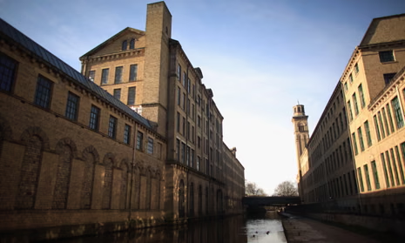
Arriving in BRADFORD
  Over 65 years ago, many people came to Bradford from places like India, Pakistan, Bangladesh.
  They came to work in big factories called mills that made cloth from wool.
  At first, mostly men came alone to work, then later their families joined them.
  They brought their languages, clothes, food, and religions like Islam, Hinduism, and Sikhism.
  Today, Bradford is a special city with many different people and cultures living together!
Have you spotted buildings like this around Bradford? They’re called textile mills!

Slide 12
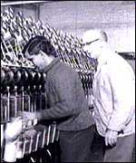
Arriving in BRADFORD
  Over 65 years ago, many people came to Bradford from places like India, Pakistan, Bangladesh.
  They came to work in big factories called mills that made cloth from wool.
  At first, mostly men came alone to work, then later their families joined them.
  They brought their languages, clothes, food, and religions like Islam, Hinduism, and Sikhism.
  Today, Bradford is a special city with many different people and cultures living together!
This is a picture of a South Asian man working in a Bradford textile mill in the 1960s!

Slide 13
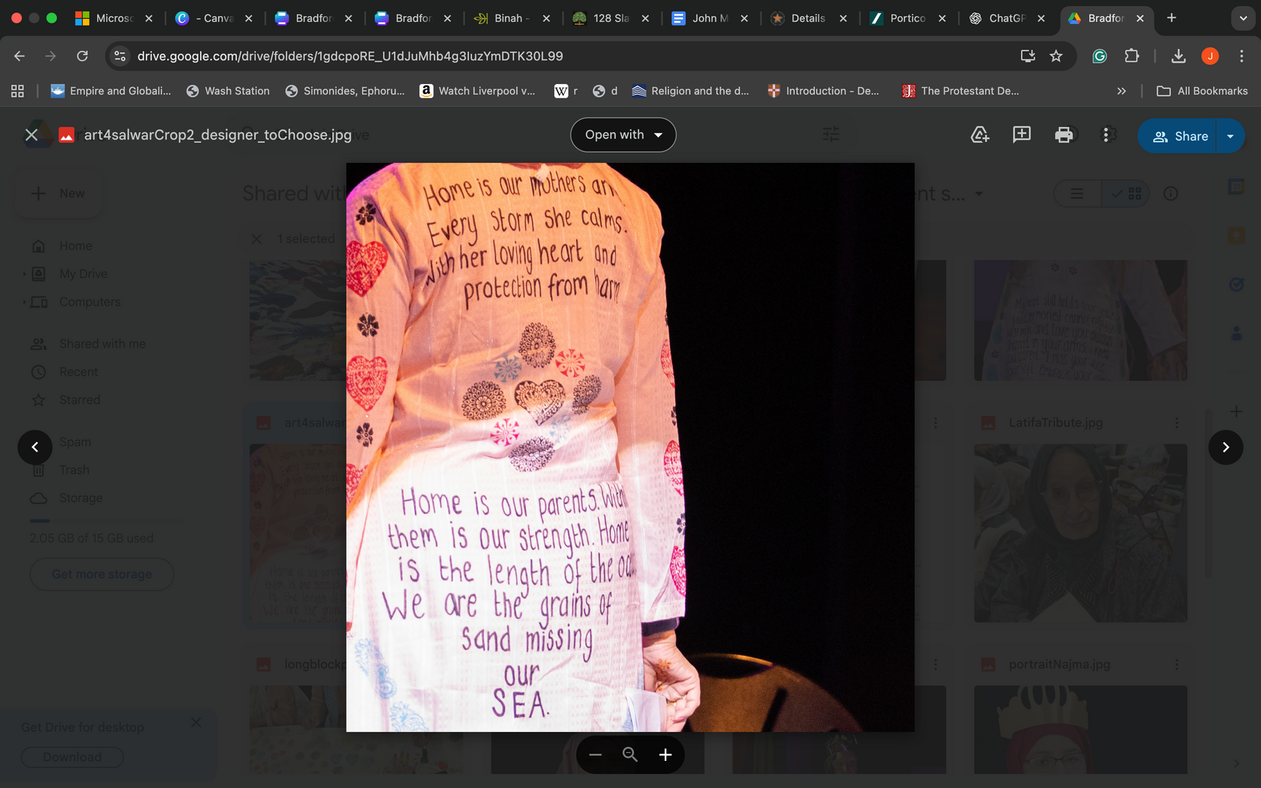
Home by Sharena Lee Satti
Home is our mother’s arms.
Every storm she calms.
With her loving heart and
protection from harm.
Home is our parents.
With them is our strength.
Home is the length of the ocean.
We are the grains of sand missing our sea.

Slide 14
Home by Sharena Lee Satti
Home is our mother’s arms.
Every storm she calms.
With her loving heart and
protection from harm.
Home is our parents.
With them is our strength.
Home is the length of the ocean.
We are the grains of sand missing our sea.
Some words from this poem were block printed by hand onto a shalwar kameez by people in the Routes to Roots project.
A shalwar kameez is a colourful and comfy outfit from countries like India, Pakistan, and Bangladesh.
Both girls and boys wear it for festivals, prayers, and special days.

Slide 15
Home by Sharena Lee Satti
Home is our mother’s arms.
Every storm she calms.
With her loving heart and
protection from harm.
Home is our parents.
With them is our strength.
Home is the length of the ocean.
We are the grains of sand missing our sea.
  What do you think the poem is saying about home?
  Why do you think the poem was sewn onto a shalwar kameez?
  Have you ever seen someone sewing or worn clothes that were handmade or decorated?
  Why is Bradford a good place for sewing and sharing stories like this?

Slide 16


Write your own poem about home on to a shalwar kameez!
Maybe think about...
What your home looks and feels like. Is it noisy or quiet? What colours are there?
What makes your home special? Is it the people, the food, your toys, or your room?
What sounds do you hear at home or outside your window? Birds, cars, people talking?
If your home was an object, what would it be? A warm blanket? A shining light? A strong tree?
You could think from someone else’s point of view. What would your parents, grown-ups or a friend say about your home?
What language will you use in your poem? You can use your home language, English, or both!

