Slide 1












Routes to Roots
A celebration of migration
KS3 Learning Resource

Slide 2
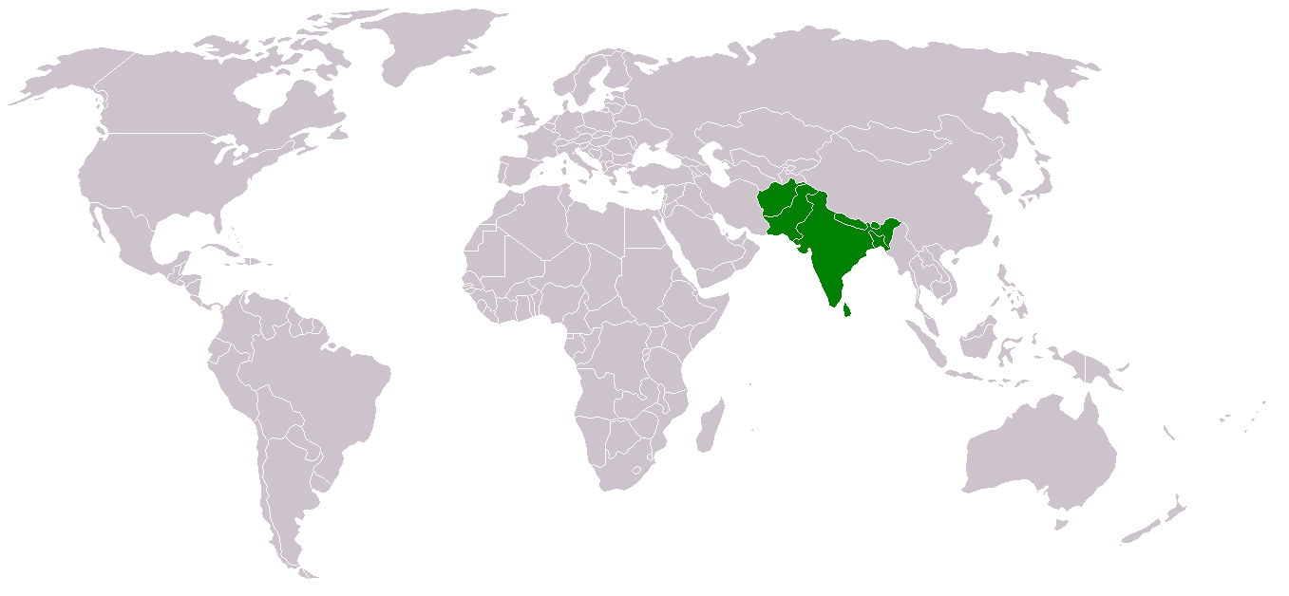
What is Routes to Roots?
Routes to Roots celebrates South Asian people and their experiences, moving to the UK.
South Asian people have been living in the UK for hundreds of years. Lots of British life today has been influenced by the people who have migrated from the Indian subcontinent, from the tea we drink, to doing yoga and the word pyjamas!
South Asian countries include: Afghanistan, Bangladesh, Bhutan, India, the Maldives, Nepal, Pakistan, and Sri Lanka.

Slide 3
What is Migration?

Slide 4

What is Migration?
Migration means...
going from one place to another. For example, somebody moving house from somewhere else in the country or world to Bradford. Or, maybe somebody moving from another country to Britain.

Slide 5
What is Diversity?
Migration means...
going from one place to another. For example, somebody moving house from somewhere else in the country or world to Sheffield. Or, maybe somebody moving from another country to Britain.

Slide 6
What is Diversity?
Migration means...
going from one place to another. For example, somebody moving house from somewhere else in the country or world to Sheffield. Or, maybe somebody moving from another country to Britain.
Diversity means...
the things that make people different. So this could be their life experiences, their age, the place that they come from, their gender, their hair or eye colour, how curly or straight somebody’s hair is, their skin colour, their religion. There are lots of different things that makes us who we are.

Slide 7
Different communities from around the world have settled in Britain for thousands of years. What do you think that tells us?

Slide 8
Push and Pull Factors
Pull factors are the positive characteristics of a place that attract people to them. This could include better jobs, education, healthcare and safety.
Push factors are the negative characteristics of a place that cause people to move away. This could include a lack of jobs, famine, war and natural disasters.
Can you think of any more push and pull factors?

Slide 9
Types of Migration
Internal migration is the movement of people within the same country.
Economic migration is the movement of people for economic reasons.
Forced migration occurs because people are under threat or in danger and are forced to flee their home/country.

Slide 10
Can you think of any historic or current examples of migration? Which category do the examples you have come up with fit into?

Slide 11
How might it feel to migrate?

Slide 12
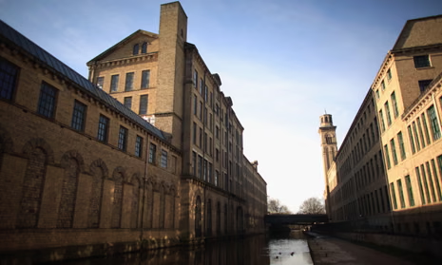
South Asians in Bradford - The Textile Connection
  Bradford has a strong history of making wool textiles since the 1800s.
  It was called the “wool capital of the world” because of its many big mills.
  Mills are large factories where wool was cleaned, spun, and woven into fabric—full of noisy machines and busy workers.
  After World War II, Bradford needed more workers to keep the mills running.
  Many South Asian migrants came in the 1950s and 60s to work in these tough conditions—long hours, loud noise, and low pay.
  Their hard work helped Bradford stay important in the world of textile making.
This is a textile mill in Bradford.

Slide 13
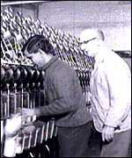
South Asians in Bradford - The Textile Connection
  At first, mostly young men came alone to work and support their families back home.
  Later, they brought their families and settled in Bradford.
  They brought their languages (Urdu, Punjabi, Bengali), religions (Islam, Hinduism, Sikhism), clothes, and food.
  They opened shops, mosques, temples, restaurants, and community centres.
  Today, South Asians make up about 32% of Bradford’s population and have shaped the city’s culture and festivals like Eid, Diwali, and Mela.
  Bradford is now one of the most diverse cities in the UK!
A South Asian man working in a textile mill in Bradford.

Slide 14
Home by Sharena Lee Satti
Home is where love is
Where happiness lives
Where peace is
Home is childhood memories
Where families live
Memories remain sweet and warm
Like the rainbow after the storm
Home is our parents
Within them is our strength
Home is length of the ocean
We are the grains of sand missing our sea
Home was like heaven before marriage
No isolation, no loneliness
No path to darkness
Home is our Mothers arms
Every storm she calms
With her loving heart and protection from harm
Home is the smallest of things that
That only happiness can bring
When you see your children coming home from school
In a world where life can be cruel
Home is happiness, home is family home is our mothers arms.

Slide 15
Home by Sharena Lee Satti
جہاں خوشیاں رہتی ہیں۔
جہاں امن ہو۔
گھر بچپن کی یادیں ہیں۔
جہاں خاندان رہتے ہیں۔
یادیں میٹھی اور گرم رہتی ہیں۔
جیسے طوفان کے بعد قوس قزح
گھر ہمارے والدین ہیں۔
ان کے اندر ہماری طاقت ہے۔
گھر سمندر کی لمبائی ہے۔
ہم اپنے سمندر سے محروم ریت کے ذرے ہیں۔
شادی سے پہلے گھر جنت جیسا تھا۔
کوئی تنہائی نہیں، تنہائی نہیں۔
اندھیرے کا کوئی راستہ نہیں۔
گھر ہماری ماؤں کا بازو ہے۔
ہر طوفان کو وہ پرسکون کرتی ہے۔
اس کے پیارے دل اور نقصان سے تحفظ کے ساتھ
گھر سب سے چھوٹی چیز ہے۔
جو صرف خوشی لا سکتی ہے۔
جب آپ اپنے بچوں کو سکول سے گھر آتے ہوئے دیکھیں گے۔
ایک ایسی دنیا میں جہاں زندگی ظالمانہ ہو سکتی ہے۔
گھر ہی خوشی ہے، گھر ہی خاندان کا گھر ہے ہماری ماؤں کی بانہوں

Slide 16
Home by Sharena Lee Satti
  What are your reflections on the poem? What do you think the writers are sayng?
  Why might migrants feel both sadness and hope when they think or write about their home?
  In what ways can writing about home help migrants keep their culture and family close, even if they live far away?
  Why do you think it’s important for migrants to write about home in their own language? How can writing in your first language help you express your feelings better?

Slide 17
Write your own poem about home. You could...
  Think about the perspective you’re writing from. It could be your own, a family member’s, or a made-up person who has migrated to a new country. How do they feel about home? What do they miss or hope for?
  Describe your home using your five senses. What does it look like, smell like, feel like? What can you hear? What can you taste?
  Think about a special memory in your home. Write about what happened and how it made you feel.
  What does home mean to you? Is it a place, people, feelings, or something else?
  Imagine you are far away from home. Write about what you miss the most and why.
  Write about the people who make your home special. How do they show love or care?
  Describe the sounds or sights of your neighbourhood or street. How do they make you feel?
  Use a symbol or object to represent home. For example, a tree, a door, or a light. Explain why you chose it.
  Think about the language of your poem. Will you write your poem in one language or use more than one? How does using your own language, or mixing languages, help you express your feelings about home?

